Slide 1
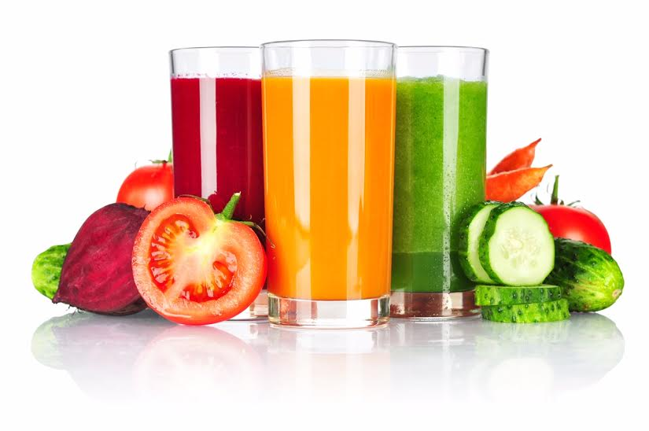
Soothe-Me Smoothie
Bringing wellness goals together!
Smoothies & therapeutic massage for your lifestyle

Slide 2
Support for your health & Wellness Journey!
Registered Dietitians
Dawn Blocklinger RD, LDN
Stefanie Djuric RD, LDN
Licensed Massage & Bodywork Therapist
MaryAnn Shelton LMBT

Slide 3
Preview: Featured Smoothies
Cherry Berry Smoothie - Designed to reduce inflammation and support healthy sleep
- Massage & Inflammation: chronic pain, & joint health
Super Green- -Designed to enhance digestion and liver function
- Anxiety & depression (a forgotten link in overall gut health)- How can massage help?
PB & Chocolate Banana Cream Smoothie-
- This creamy smoothie is designed to be your highest protein smoothie
- Maintaining healthy circulation , fascia, & flexibility, what are trigger points?
Health benefits of Incorporating Greens
Types of Massage & Bodywork

Slide 4
Ingredients
Every smoothie is designed with a combo of:
Carbohydrates
Proteins
and Fats to stabilize your blood sugar while providing a variety of nutrients to enhance your overall health!
Do not be afraid of the higher healthy fat content (we benefit from healthy fats and they help us to feel satisfied)
All smoothies are gluten-free & dairy-free

Slide 5
Cherry Berry
Designed to reduce inflammation & support healthy sleep
Tart cherry juice- anti-inflammatory superpowers help reduce post-exercise soreness
Wild blueberries- anti-aging power of anti-oxidants, protect against inflammation, thought to be a leading cause in brain aging
Chia seed-plant source of omega-3 fatty acids known to decrease cholesterol and control blood sugar

Slide 6
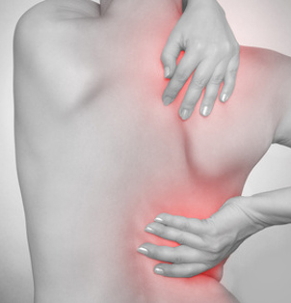
Massage & Inflammation
Inflammation can be positive or negative to our level of homeostasis or “balance”
The inflammatory response is a normal mechanism that usually speeds recovery from illness or injury.
We need a certain amount of healthy inflammation at injury sites…. For the influx of fresh blood and nutrients.

Slide 7
Massage & Inflammation (cont.)
Disease or “dis-ease” when the body is not at ease
ROM massage -Stimulates the production of synovial fluid in joints = Increased joint health
Massage also stimulates mitochondria (the tiny powerhouses inside cells that convert glucose into energy essential for optimal cell function & repair)

Slide 8
How does Massage assist in obtaining deep sleep & relaxation?
Massage causes a decrease in Cortisol levels (usually indicative of stress)
an Increase of Serotonin/Oxytocin
(which balances sleep & mood, reduces anxiety & aggression)
Massage also increases Dopamine another one of our “feel-good” hormones involved in regulating emotion, mood, and motor control

Slide 9
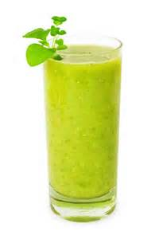
Super Green
Designed to enhance digestion and liver function.
Wheatgrass- Improves the digestive system
Spirulina Powder- considered one of the world’s most nutritious foods because of it’s B vitamins and antioxidant properties to prevent against oxidative damage.
Hemp Protein powder- contains all 21 amino acids making it an excellent source of protein.
Maca root powder- rich in vitamins, minerals, essential fatty acids which naturally support energy levels.
Tumeric root powder and ginger root Powder- powerful anti-inflammatory and antioxidant properties.

Slide 10
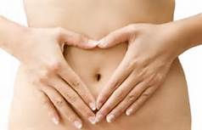
How can massage improve my digestion?
Physiological benefits of therapeutic massage on the digestive system:
Indirectly normalizes digestive functions through normalization of the Autonomic Nervous System
Improves tone and function of the large and small intestines
Massage aids in the stimulation of peristalsis of the intestines
Specific protocols (soft/ sweeping strokes on the lower abdomen) for “getting things moving”

Slide 11
Peanut Butter & Chocolate Banana Cream
This creamy smoothie is designed to be your highest protein smoothie!
Pea, Brown Rice, Quinoa- Combo of three powerful protiens to help keep your metabolism running, energy up and reduce muscle loss.
Banana- high in potassium and promotes heart health and normal blood pressure.

Slide 12
Consuming proper proteins and receiving therapeutic massage is Especially Important with new routine of mechanical use!
This aids in keeping the musculoskeletal systems in balance as new use stresses the body.

Slide 13
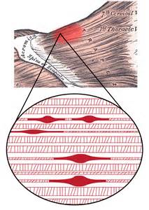
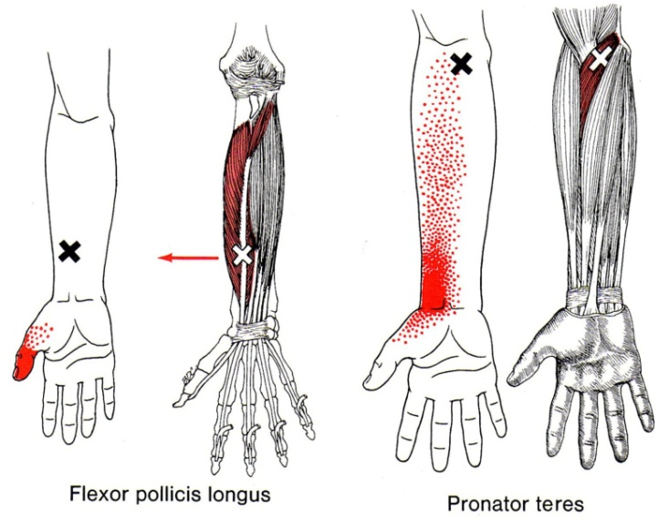
Maintaining healthy circulation, fascia, & flexibility is vital to our overall health!
What are trigger points?
Clinical Definition of an active trigger point:
Causes a clinical pain complaint
It is always tender
Prevents full lengthening of muscle
Weakens the muscle
Refers a patient recognized pain on direct compression
Localized pressure is applied to release
Trigger points play a major role in how healthy our muscles are
“knots” can harbor a trigger point

Slide 14
How can massage improve my athletic performance? Research confirms that massage can:
Relax and soften injured, tired, and over-used muscles
Increase joint flexibility
Help athletes of any level prepare for, and recover from strenuous workouts.
Promote tissue regeneration, reducing scar tissue & stretch marks
Reduce spasms & cramping
Exercise and stretch weak, tired or atrophied muscles
Pump oxygen and nutrients into tissues and vital organs, improving circulation.
Reduce post-surgery adhesions and swelling
Release endorphins-amino acids that work as the body’s natural pain-killer
Enhance immunity by stimulating lymph flow-the body’s natural defense system

Slide 15
Health benefits of Incorporating Greens
Bone health
Healthy Microbiome
Sharpen your eyesight
Help your muscles

Slide 16
Health Benefits of Salad Greens
Bone health
Just one cup of mixed greens will provide you with 100% of your daily vitamin K needs. Vitamin K is needed for absorption of vitamin D and calcium absorption to produce strong bones.
Healthy Microbiome
Salads provide fiber and vitamin K, two essential components to creating a healthy microbiome for healthy digestion. A high fiber diet can also prevent constipation.

Slide 17
Health Benefits of Salad Greens (cont.)
Sharpen your eyesight
Each day’s salad is rich in vitamin A, lutein and zeaxanthin- very important nutrients no matter what your age. Vitamin A helps eyes adapt from bright light to darkness. Lutein and zeaxanthin can help filter out high-energy light that may cause eye damage from free radicals.

Slide 18
Health Benefits of Salad Greens (cont.)
Help your muscles
Vitamin C helps produce collagen, a connective tissue that holds muscles, bodes and other tissues together.
It protects you from bruising by keeping capillary walls and blood vessels firm. It helps your body absorb iron folate from plant food sources. Inadequate iron in the body can impair aerobic metabolism by decreasing the delivery of oxygen to tissues and reducing the capacity of muscles to use oxygen for the oxidative production of energy.

Slide 19
Smoothie Guidelines and MaryAnn’s Signature recipe
All Ingredients should be organic
Small handful of almonds/walnuts
1 ½ carrot
¼ cucumber
1 teaspoon chia seed
1 teaspoon flax seed
1 teaspoon coconut
½ teaspoon Peanut Butter powder
2 sprigs of celery
¼ cup pineapple juice
Small dash of lemon and lime juice
2 radishes
¼ mid-size beet
¼ cup frozen or fresh Kale/Spin
¼ frozen apple or blueberries or strawberries
1 banana
Nutri-bullet Super greens ½ teaspoon
Pure liquid ionic magnesium
Dash of cinnamon
½ teaspoon Youngevity (beyond osteo-fx)
¼ teaspoon spirulina

Slide 20
Low Impact “deep tissue” massage
My therapy design is unique to each person, & treats the whole person.
I think of myself as an “awareness coach”
Effective change comes to the body when the body becomes aware of what it is doing to itself.
(This increases the stimulus to the Central nervous System)-
Which sends a signal that the body can respond to!
Modalities that are Low Impact, yet highly effective
Cupping
PIR (post isometric relaxation)
Swedish
Aromatherapy
Orthobionomy techniques
Systematic Anatomy Trains Approach
Shiatsu
Maintaining a regular massage schedule actually increases the body’s natural mechanisms to relax faster on it’s own!!

Slide 21
Tensegrity
- Strain distribution
And the Fascial Release Technique
Anatomy Trains- Muscles working together to get to an end-goal

Slide 22
Thank YOU!!!
Please take a copy of the smoothie recipes you tasted this evening!
I hope all of you reach out to the resources you were introduced to this evening!
There is also additional information on Massage therapy for different needs as well as the different modalities that I offer and literature on essential oils, which enhances my work.
Tomorrow evening @ the Chateau Hotel & Conference Center (4-8 pm) I am hosting an essential oils make-n-take and gift certificate pick-up!

